Slide 1
The Value of Physical Layer Clocking for IEEE 1588 Partial Timing Support
David Spencer – Product Line Manager, Skyworks Solutions Inc.
ITSF 2021

Slide 2
Full & Partial Timing Support
Full Timing Support expects Physical-layer Frequency Assistance
Partial Timing Support Allows Physical-layer Frequency Assistance as an Option

Slide 3
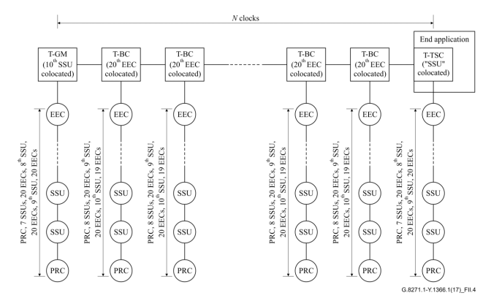
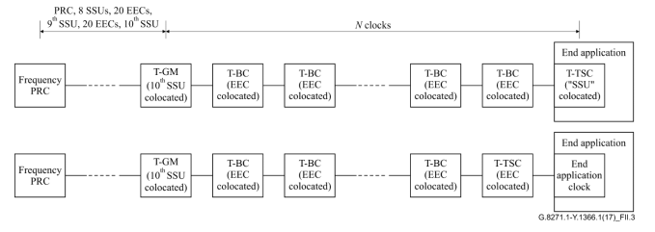
Flavors of Frequency Assist
Congruent
Non-Congruent
Physical layer clock from PRC common with PTP T-GM
  Typically, Synchronous Ethernet
PTP tick rate and physical frequency match
Physical layer clock from different PRC to T-GM
  Could be Synchronous Ethernet or could be BITS etc.
PTP tick rate and physical frequency not aligned
3

Slide 4
Non-Congruent Examples
Local
External stable frequency is available directly to the slave
Example: PTP device located in a central office with local BITS/SSU
Remote
External stable frequency injected further back in the network
  Transported to slave over Synchronous Ethernet
Example: Central office providing local access network with Synchronous Ethernet
4

Slide 5

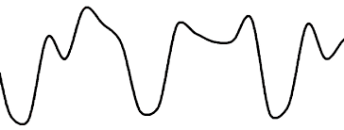
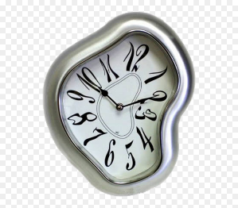

What Use Is a Stable Frequency?
Timestamping accuracy
  PHY-level timestamping against a local clock minimizes static and dynamic error
  Only relevant for Synchronous Ethernet – not local congruent operation
Local oscillator requirements
  Can relax local oscillator short-term stability requirements (TCXO instead of OCXO)
Time recovery servo performance
  Coherent, congruent clock can improve operation
  Tick rate is available at hardware level
Holdover
  Removes long-term stability requirements on oscillator
5

Slide 6
What Use Is a Stable Frequency?
Timestamping accuracy
  PHY-level timestamping against a local clock minimizes static and dynamic error
  Only relevant for Synchronous Ethernet – not local congruent operation
Local oscillator requirements
  Can relax local oscillator short-term stability requirements (TCXO instead of OCXO)
Time recovery servo performance
  Coherent, congruent clock can improve operation
  Tick rate is available at hardware level
Holdover
  Removes long-term stability requirements on oscillator
Effect will be minimal (<50 ns)
Can be ignored
6

Slide 7
What Use Is a Stable Frequency?
Timestamping accuracy
  PHY-level timestamping against a local clock minimizes static and dynamic error
  Only relevant for Synchronous Ethernet – not local congruent operation
Local oscillator requirements
  Can relax local oscillator short-term stability requirements (TCXO instead of OCXO)
Time recovery servo performance
  Coherent, congruent clock can improve operation
  Tick rate is available at hardware level
Holdover
  Removes long-term stability requirements on oscillator
Effect will be minimal (<50 ns)
Can be ignored
Cost saving for equipment vendor
But would restrict usage
7

Slide 8
What Use Is a Stable Frequency?
Timestamping accuracy
  PHY-level timestamping against a local clock minimizes static and dynamic error
  Only relevant for Synchronous Ethernet – not local congruent operation
Local oscillator requirements
  Can relax local oscillator short-term stability requirements (TCXO instead of OCXO)
Time recovery servo performance
  Coherent, congruent clock can improve operation
  Tick rate is available at hardware level
Holdover
  Removes long-term stability requirements on oscillator
Effect will be minimal (<50 ns)
Can be ignored
Cost saving for equipment vendor
But would restrict usage
Concentrate on benefit of these
8

Slide 9
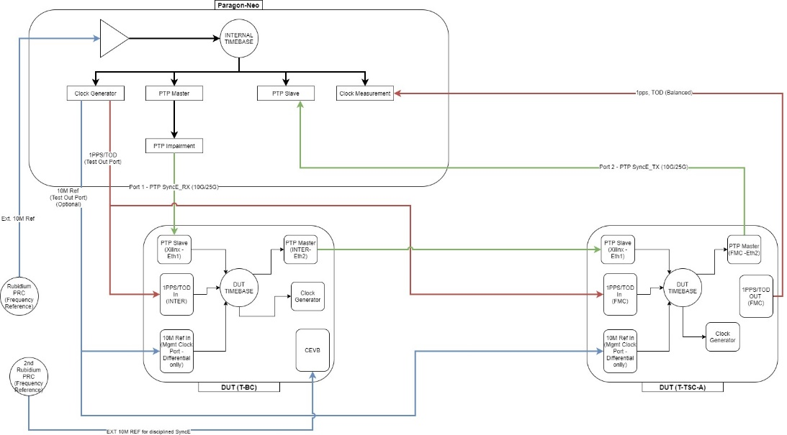
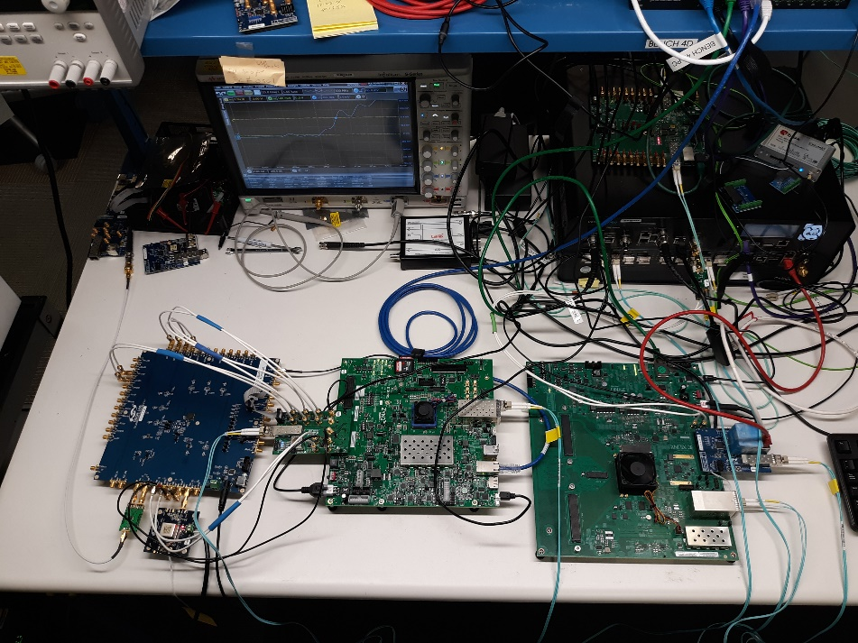
The Test Setup
Calnex Paragon Neo – Master, Impairment Generation & Measurement
Boundary Clock to Allow SyncE Flow Control
Slave

Slide 10
Servo Performance Measurements
PTP-Only
Max TIE = 1.00 µs
Remote Frequency
Max TIE = 910 ns
Congruent
Max TIE = 620 ns

Slide 11
Holdover Measurements
PTP-Only
With Frequency Assist
Full holdover
  No external time or frequency source available
  Holdover stability determined entirely by local oscillator
Time holdover operation
  Local clock maintains previous alignment and continues to tick from physical layer frequency

Slide 12
Conclusions
Physical layer support clearly provides benefit to both PTP-locked and holdover operation
PTP-locked operation
  Adding a non-congruent physical frequency gives ~10% time alignment improvement
  However, a fully congruent Synchronous Ethernet configuration gives ~40% improvement
    But requires an architected network
Holdover operation
  Any form of frequency assistance can offer much improved holdover performance
Either local or remote non-congruent frequency assistance could offer an optimal trade off between performance improvements and deployment cost
12

